Slide 1
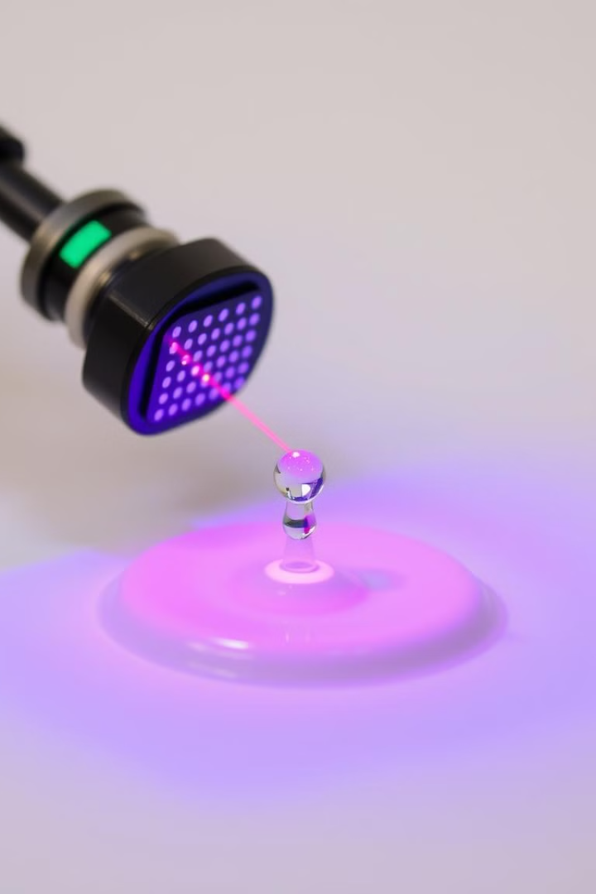
Classifying Liquids with LiDAR
Team Members: Amit Kumar (20CS30003), Rahul Mandal (20CS30039), Rohit Kumar Prajapati (20CS30041) Group Lead: Aritra Hota

Slide 2
Introduction
The application of LiDAR for classifying liquids has gained traction due to its ability to perform contactless fluid analysis by capturing laser speckle patterns. When coherent laser light is directed at a liquid, light scattered by particles within it forms a speckle pattern whose fluctuations reflect key properties like viscosity. This phenomenon, known as laser speckle reflectometry, reveals differences in viscosity based on the rate of Brownian motion within the liquid, which is affected by particle size and density.
1
Stable Speckle Patterns
2
Rapid Fluctuations
3
Smartphone LiDAR
Lower-viscosity liquids produce patterns with more rapid fluctuations.
Recent advancements have leveraged smartphone LiDAR technology for speckle pattern analysis, expanding the accessibility of liquid classification techniques.
Higher-viscosity liquids tend to exhibit more stable speckle patterns.

Slide 3
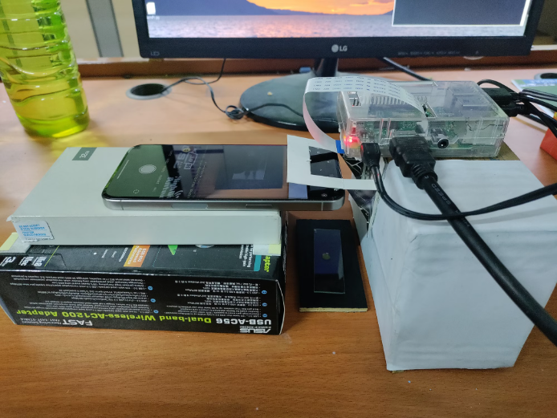
Experimental Setup
The experimental setup for classifying liquids using LiDAR comprises a smartphone-based LiDAR sensor, a Raspberry Pi for data acquisition and processing, and a custom-built liquid holder with proper alignment for laser projection and speckle capture.
1. Smartphone with LiDAR Projection 2. Raspberry Pi and Camera Interface 3. Wooden and Glass Slab for Liquid 4. Structural Stability

Slide 4
Data Collection
We utilized an iPhone 15 Pro Max for its LiDAR sensor capabilities, alongside a Raspberry Pi NoIR Camera V2 (without an infrared filter) to capture time-varying speckle patterns generated by liquid samples. This setup enabled us to analyze the Brownian motion of particles in the liquid samples and their correlation with viscosity changes.
Experimental Conditions
Liquid Volume
To maintain consistent environmental conditions across all tests, each liquid sample was measured at room temperature and in a controlled relative humidity environment.
Experiments were conducted with minimal liquid quantities, specifically between 10 𝜇L to 50 𝜇L.
Camera Settings
Distance and Surface
The camera’s shutter speed was set to 1/30 s with a 2x zoom applied.
A fixed distance of 8 cm was maintained between the LiDAR-equipped iPhone and the liquid droplet. Non-reflective surfaces and minimal background light further reduced potential interference in speckle pattern generation.

Slide 5





Materials and Sample Selection
Our selection criteria focused on commonly used opaque liquids, as transparent liquids were unsuitable for our technique due to the need for consistent speckle patterns. With transparent liquids, the LiDAR signal might:
Pass through the liquid and reflect off the container bottom
Create internal reflections within the liquid
Result in scattered measurements due to refraction
Milk
Mango Juice
Tomato Sauce
Kesar Pista Ice Cream
Milk
Mango Juice
Tomato Sauce
Kesar Pista Ice Cream
Butterscotch Ice Cream
Butterscotch Ice Cream

Slide 6
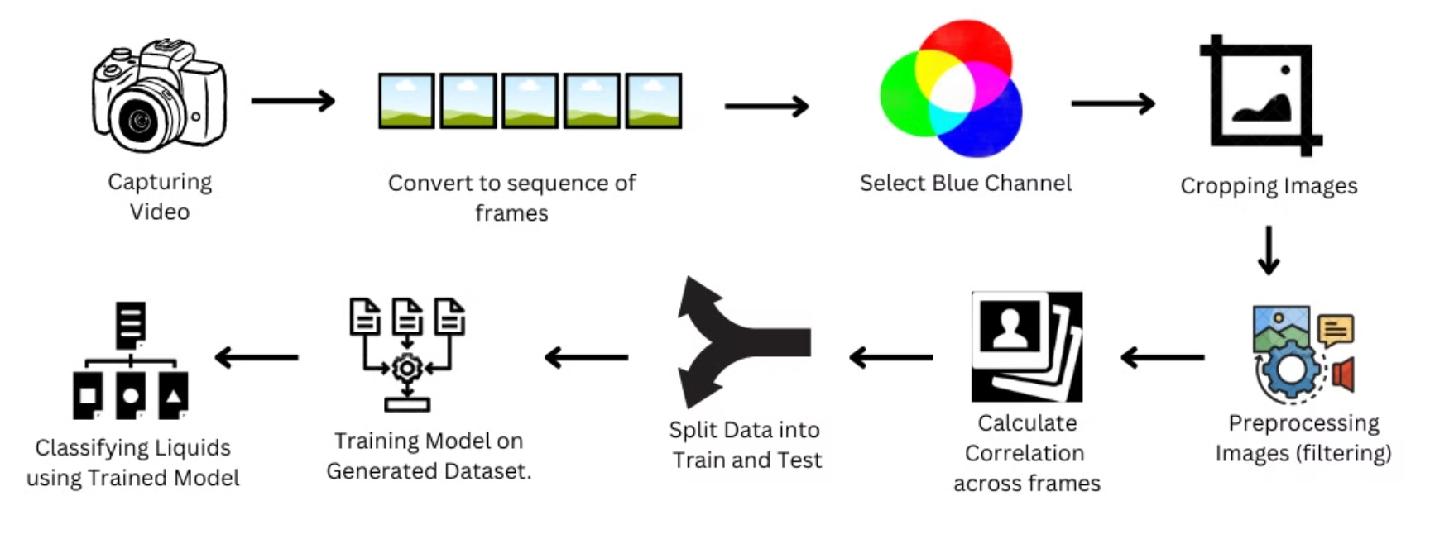
Methodology
The liquid classification approach utilizing iPhone’s LiDAR technology is organized into a structured workflow consisting of seven key stages as depicted below.

Slide 7

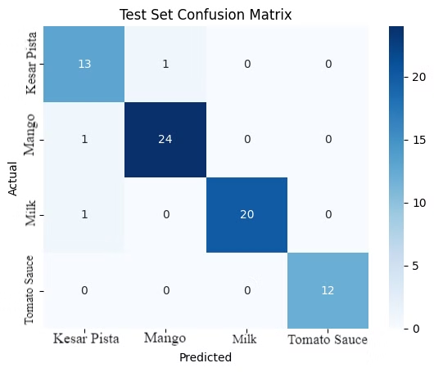
Experiments
We evaluated our LiDAR-based liquid classification system using two distinct datasets and conducted comprehensive performance analysis using various metrics. The evaluation was performed using a Random Forest classifier with a 70-15-15 split for training, validation, and testing respectively.
Liquid
Precision
Recall
F1-Score
Support
Kesar Pista
0.87
0.93
0.90
14
Mango
0.96
0.96
0.96
25
Milk
1.00
0.95
0.98
21
Sauce
1.00
1.00
1.00
12
Accuracy
0.96
72
Macro Avg
0.96
0.96
0.96
72
Weighted Avg
0.96
0.96
0.96
72

Slide 8
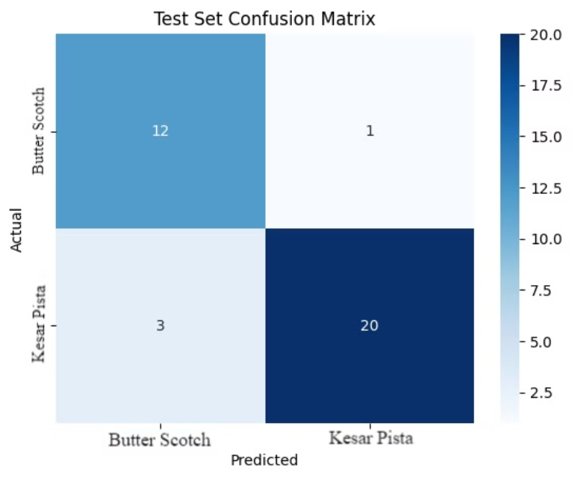
Liquid
Precision
Recall
F1-Score
Support
Butterscotch
0.80
0.92
0.86
13
Kesar Pista
0.95
0.87
0.91
23
Accuracy
0.89
36
Macro Avg
0.88
0.90
0.88
36
Weighted Avg
0.90
0.89
0.89
36

Slide 9
Key Challenges
Liquid Drop Control Issue: The dropper must release exactly one drop. Drop should maintain its shape on the slide. Proper drop formation is critical for accurate spectral pattern generation. Uncontrolled spreading affects pattern quality.
Camera Stability Concerns: Raspberry Pi camera setup requires rigid mounting. Minor camera movements significantly affect data collection. Precise LIDAR focus point requires stable imaging. Camera instability leads to poor image processing results. Need for improved mounting solution.
Data Processing Challenges: Time-consuming manual process to locate LIDAR dots. Analyzed 25 videos requiring precise position identification. Used MS Paint for manual tracking. Need for automated tracking system to improve efficiency.
Dimensional Analysis Results: Blue channel extraction was unsuccessful in 1D. Attempted analysis in higher dimensions. Tested with two different input types. No improvement observed with 3D analysis. Results remained consistent regardless of dimensionality.
Threshold Selection for LIDAR Dot Detection Purpose of Threshold: Filters frames by pixel intensity, allowing frames with LIDAR dots above the threshold to pass. Challenge: Variability: Different liquids and lighting conditions cause variations in LIDAR dot brightness. Trade-off: Low threshold may pass noisy frames. High threshold might miss valid frames with dimmer dots.

Slide 10
Potential Application
Advanced liquid analysis technology enables precise, non-invasive, and real-time characterization of liquids across industries. Example: Manufacturing process monitoring, Continuous monitoring of liquid processes, Quality assurance, etc.
Uses in Adulteration Detection and Food and Beverage Industry. Example: Identification of unauthorized additives, Detection of dilution or substitution.
Key applications include quality control in medical and healthcare. Example: Nutrient composition analysis, Contaminant detection, Freshness monitoring, Blood Coagulation monitoring, Raw material verification.
Emerging uses in agriculture and research showcase the technology’s versatility. Example: Soil solution analysis, Fertilizer quality control, Irrigation water monitoring, Pesticide concentration verification, Crop nutrition optimization.
Emerging uses in Environmental Monitoring. Example: Water quality analysis, Pollution detection, etc.

Slide 11
Conclusion
This research presents a novel approach to liquid classification using LiDAR technology, demonstrating the potential of speckle pattern analysis for non-invasive liquid identification. Our methodology achieves significant results with classification accuracies of 96% for multi-class liquid identification and 89% for binary classification between similar liquids.
The system’s ability to achieve high precision and recall scores across different liquid types demonstrates its potential for practical applications in quality control, food safety, and liquid authentication scenarios.

Slide 12
Future Scope
1. Application Extensions:​
Expansion of the liquid database to include a wider range of substances
Development of mobile applications for easy deployment and use
Integration with IoT systems for automated quality control
Investigation of temporal changes in liquid properties over extended periods
2. Research Areas
Exploration of advanced deep learning architectures for pattern recognition
Investigation of multi-modal sensing approaches combining LiDAR with other technologies
Study of temperature and environmental effects on classification accuracy
Analysis of micro-particle detection capabilities for contamination assessment
3. Specific areas of improvement include:
Development of more sophisticated preprocessing algorithms to handle varying environmental conditions
Investigation of multi-parameter analysis beyond viscosity
Creation of standardized testing protocols for different liquid types

Slide 13

Video
LINK : https://youtu.be/DloqjP_g1IE

